Slide 1
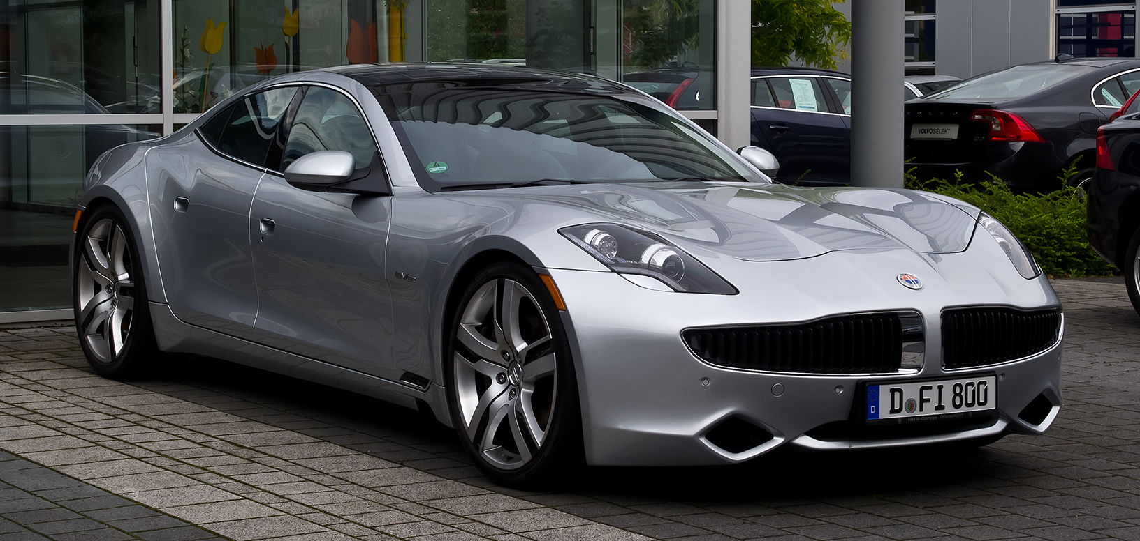

KARMA CAR OWNER TOKEN
During the past weekend, we made this project at the Wanxiang Blockchain Hackathon.

Slide 2
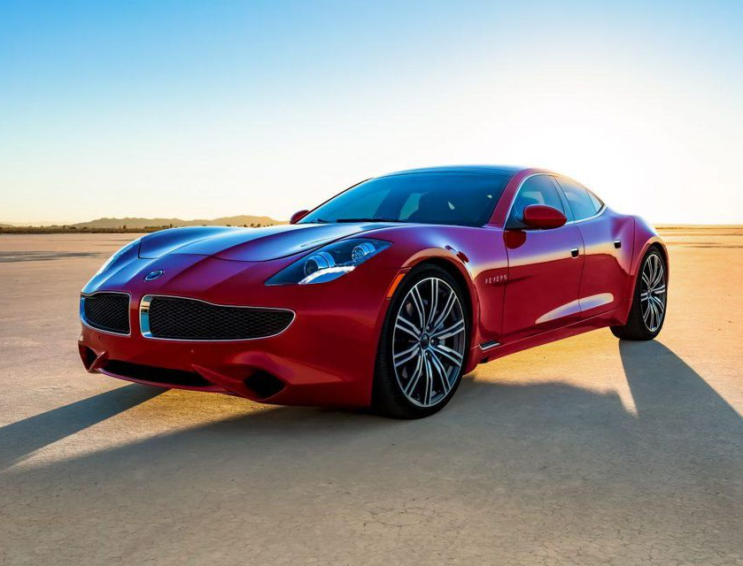
WHY CAR
The hackathon is about “Blockchain and Automotive Industry”
WHY KARMA
KARMA is the main sponsor for the hackathon
ANY OTHER REASON?
Notes:
Car token is good example to explain the two concepts: a frictionless market, achieved by tokenising assets; and the integration of the web, by using the token as an integration point for web services. We demonstrate with an example that encompasses both concepts: car token.
On the one hand, a car is a tokenised asset, that can be bought, sold, transferred, auctioned, collaborated and insured, all enabled by blockchain.
On the other hand, a car also has utility. A car's ownership token can convert a blockchain wallet into a car key, with additional functions like graphically representing the car's current location. Authorising someone to access your car, or renting it for profit, would be seamlessly done by signing blockchain transactions or attestations, without passing car keys around.

Slide 3
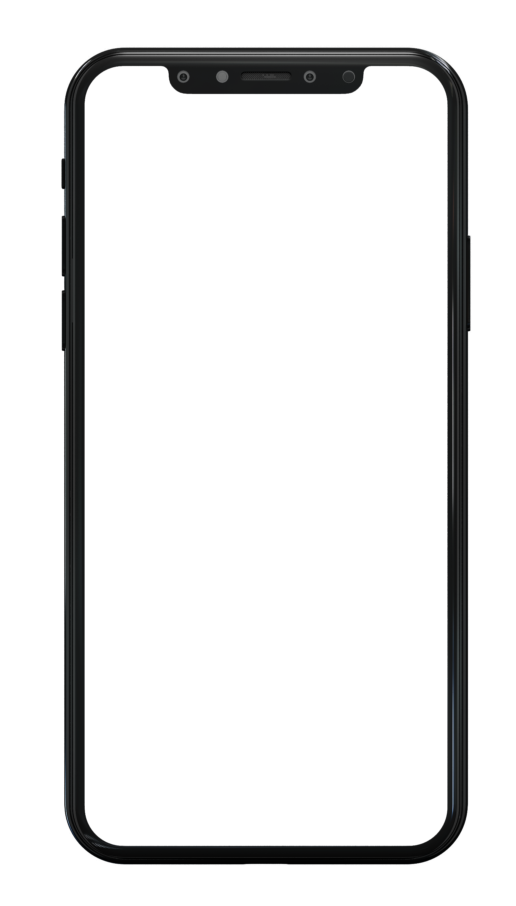
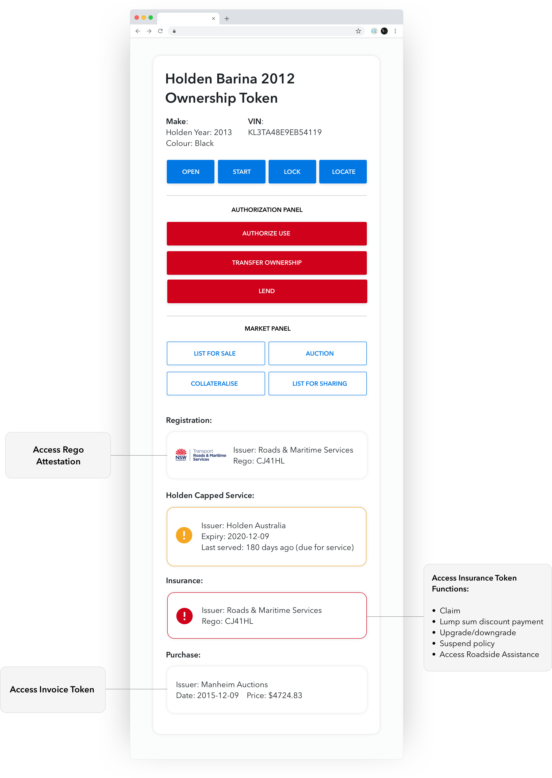
WHAT WE CAN ACHIEVE
FRICTIONLESS MARKET
INTEGRATING THE WEB
Enables serval open markets
Reselling
Sharing
Collateralizing
Services integrated through the Car Owner Token
Insurance
Rego
Services
Warranty
Uber
Any services related to your car
Atomic DvP
Minimum Friction
Better user experience
Simplify the process
Open competition for services
Notes:
At first glance, it is just a handy portal to do everything about the car, including market functions and utility. However, it's not possible with the traditional web model. In the web 2.0 model, you are restricted to handling every element on its own:
To register the car, there is a separate process which involves creating an account with the Road and Maritime Services and proving ownership manually without the aid of cryptography.
When you want to provide insurance to the car, you have to create another account and manually offer proof of its registration to that new service.
Likewise, if you want to make the car available to share economy through Uber or hour-based car rental, the work of proving and settling payments and insurance cost adds friction to the market.
The intended portal does not enable those functions by itself but merely serves as a gateway to merge a lot of different accounts as we know it from the internet of today. It's just another stopgap, which hides paper trail processes from the user, without solving the underlying problem.
Now let's reimagine this in the web3 world whereby such elements can be tokenised, step by step:
Buying and registration: The Vendor (in this case Holden) provides an ownership token to the new owner which can be used to operate the car. The token, transferred to the owner at the time of purchase, is in turn used to acquire the registration token. An inbuilt IoT device allows the car to be operated with proof of ownership via a token.
Insurance: The owner, wishing to purchase insurance, only needs to provide the proof of ownership and registration token to be qualified to fulfill the requirements with the insurance company. The insurance companies standards are met automatically by matching the tokens to their requirements and once validated; the insurance company can send the owner an insurance token in exchange for payment. The insurance token carries its own functions and services.
Token build the join between different providers and services, which are used to be built by accounts, trust and paperwork.
Uber: If the owner would like to become an Uber driver, she can easily prove her vehicle is good enough by providing proof of ownership, insurance and registration with her tokens. Uber then automatically provides her with an Uber token which, depending on the owner's need, can be used to get himself started as an Uber driver or allow a 3rd party driver to do so. None of these processes requires manual verification or account creation.
Token enable a more flexible, even programmable, use of ownership rights and their interaction, as centralised, account-based services can provide.
Self-Uber: Taking this even further, the owner can skip Uber all together and rent her car directly to strangers. Not wanting her car to be trashed by some random stranger, she can restrict her renters to those who have an attestation token issued by the 'better drivers bureau'. The renter proves they have this token, pays a sum to the owner and is atomically issued with a temporary token that allows them to unlock and use the car for a certain period of time. This is done without the creation of an account or needs to submit tons of documents to be validated manually by the owner.
Selling: If the owner wishes to sell the car, she only has to list it on any website with a price. The ownership token and payment can be swapped atomically (ensuring neither the buyer nor seller is cheated) and the new owner can drive away with the car without even meeting the original owner face to face. The new buyer knows in advance whether the car has been registered and is legally owned by merely validating the original owner's ownership token in their wallet. The original owner's token is invalidated once the swap occurs and she can no longer operate the car. It is also possible to automatically void the insurance policy once the exchange has occurred and provide the original owner with a rebate for premature cancellation.
This chapter serves to present the vision. Token enable the whole ownership and utility processes around car trading and sharing to happen automatically, fraud-proof and atomic. This eliminates a lot of friction and allows much more flexibility to individualize the economic transactions.
We will have the opportunity to inspect the technical aspect of this well-integrated well-tokenised car token in later chapters again.

Slide 4
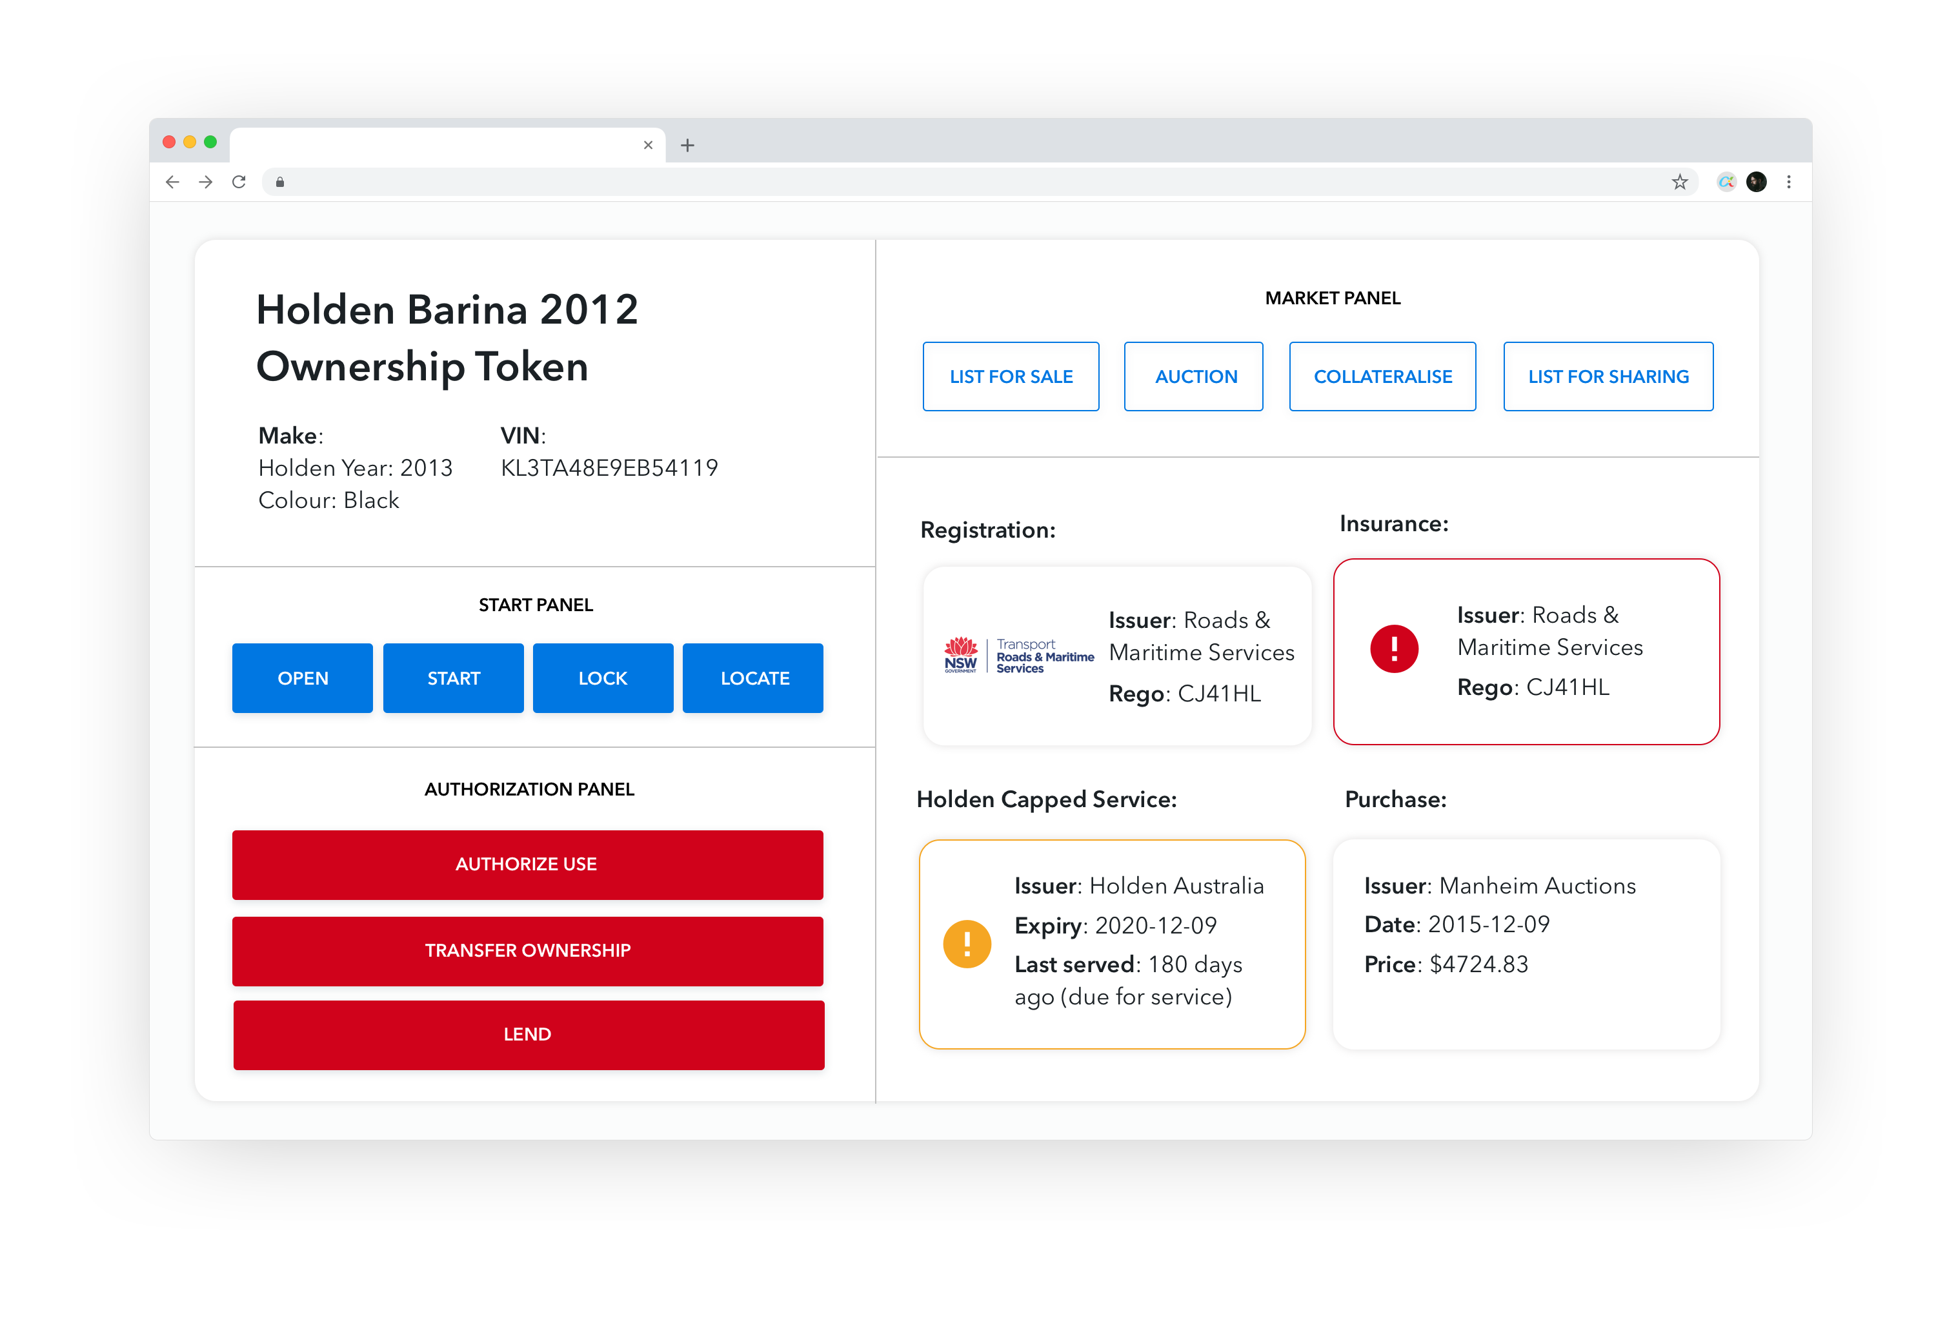
Notes:
Buying and registration: The Vendor (in this case Holden) provides an ownership token to the new owner which can be used to operate the car. The token, transferred to the owner at the time of purchase, is in turn used to acquire the registration token. An inbuilt IoT device allows the car to be operated with proof of ownership via a token.
Insurance: The owner, wishing to purchase insurance, only needs to provide the proof of ownership and registration token to be qualified to fulfill the requirements with the insurance company. The insurance companies standards are met automatically by matching the tokens to their requirements and once validated; the insurance company can send the owner an insurance token in exchange for payment. The insurance token carries its own functions and services.
Token build the join between different providers and services, which are used to be built by accounts, trust and paperwork.
Uber: If the owner would like to become an Uber driver, she can easily prove her vehicle is good enough by providing proof of ownership, insurance and registration with her tokens. Uber then automatically provides her with an Uber token which, depending on the owner's need, can be used to get himself started as an Uber driver or allow a 3rd party driver to do so. None of these processes requires manual verification or account creation.
Token enable a more flexible, even programmable, use of ownership rights and their interaction, as centralised, account-based services can provide.
Self-Uber: Taking this even further, the owner can skip Uber all together and rent her car directly to strangers. Not wanting her car to be trashed by some random stranger, she can restrict her renters to those who have an attestation token issued by the 'better drivers bureau'. The renter proves they have this token, pays a sum to the owner and is atomically issued with a temporary token that allows them to unlock and use the car for a certain period of time. This is done without the creation of an account or needs to submit tons of documents to be validated manually by the owner.
Selling: If the owner wishes to sell the car, she only has to list it on any website with a price. The ownership token and payment can be swapped atomically (ensuring neither the buyer nor seller is cheated) and the new owner can drive away with the car without even meeting the original owner face to face. The new buyer knows in advance whether the car has been registered and is legally owned by merely validating the original owner's ownership token in their wallet. The original owner's token is invalidated once the swap occurs and she can no longer operate the car. It is also possible to automatically void the insurance policy once the exchange has occurred and provide the original owner with a rebate for premature cancellation.
This chapter serves to present the vision. Token enable the whole ownership and utility processes around car trading and sharing to happen automatically, fraud-proof and atomic. This eliminates a lot of friction and allows much more flexibility to individualize the economic transactions.
We will have the opportunity to inspect the technical aspect of this well-integrated well-tokenised car token in later chapters again.

Slide 5
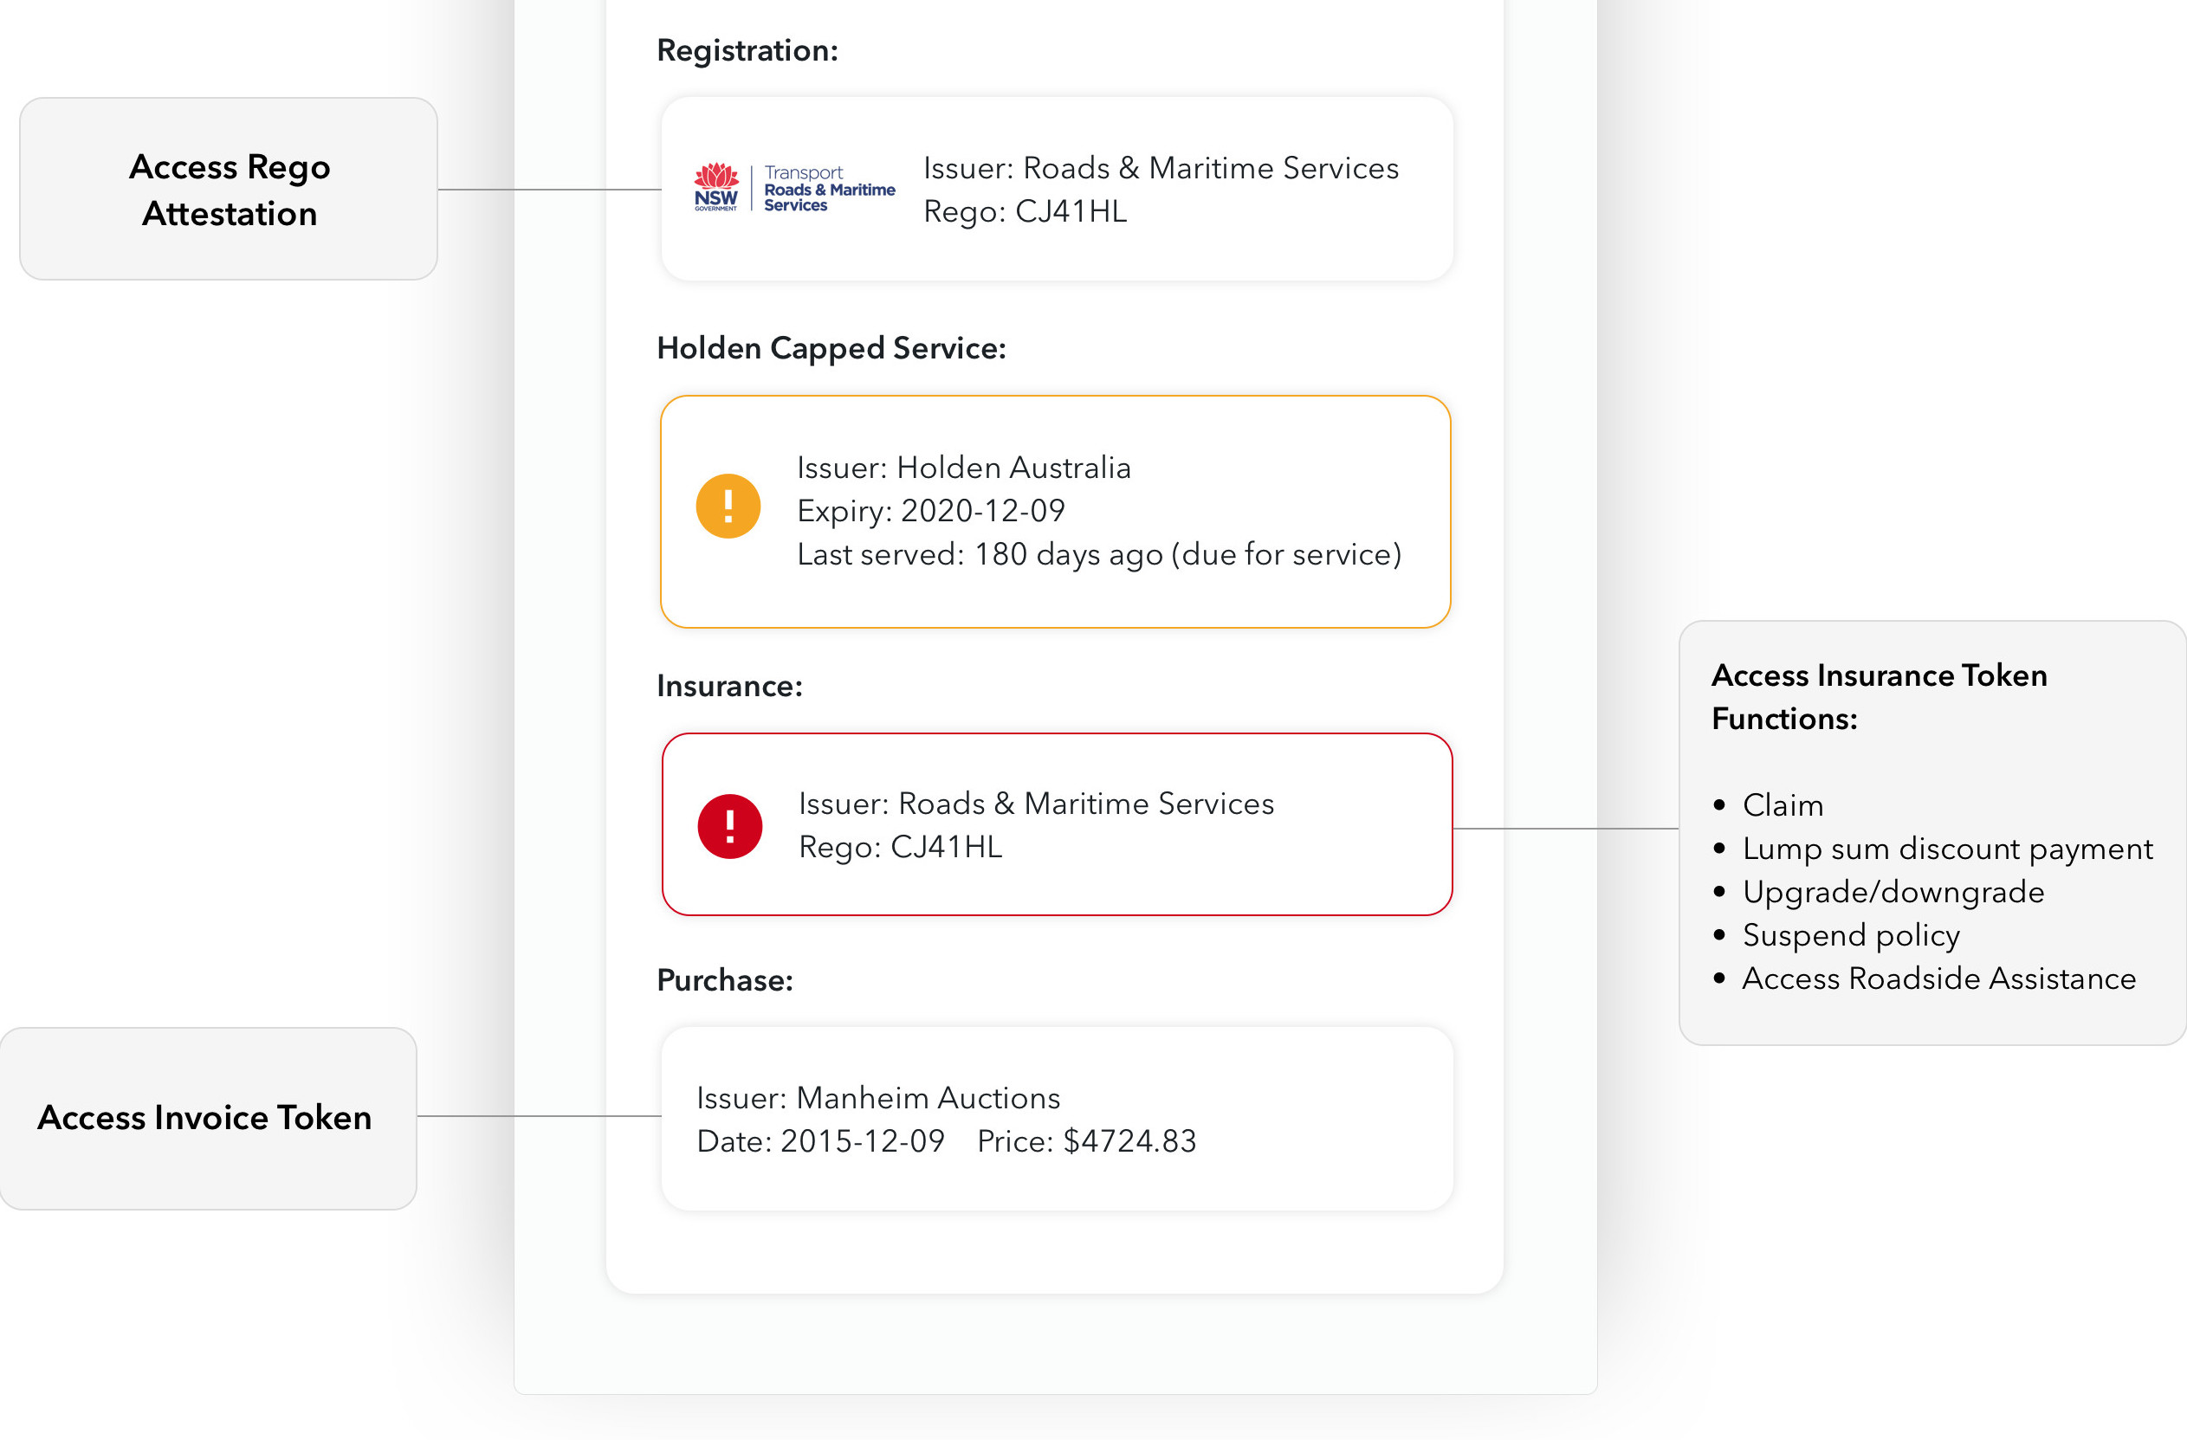

Confidential

Slide 6

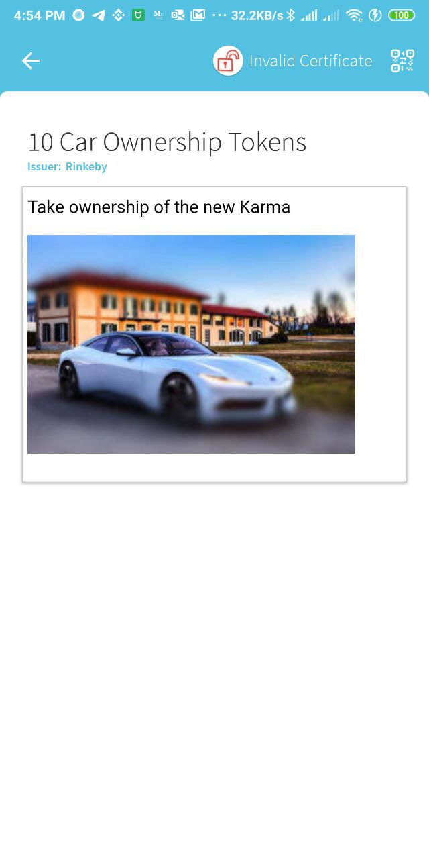
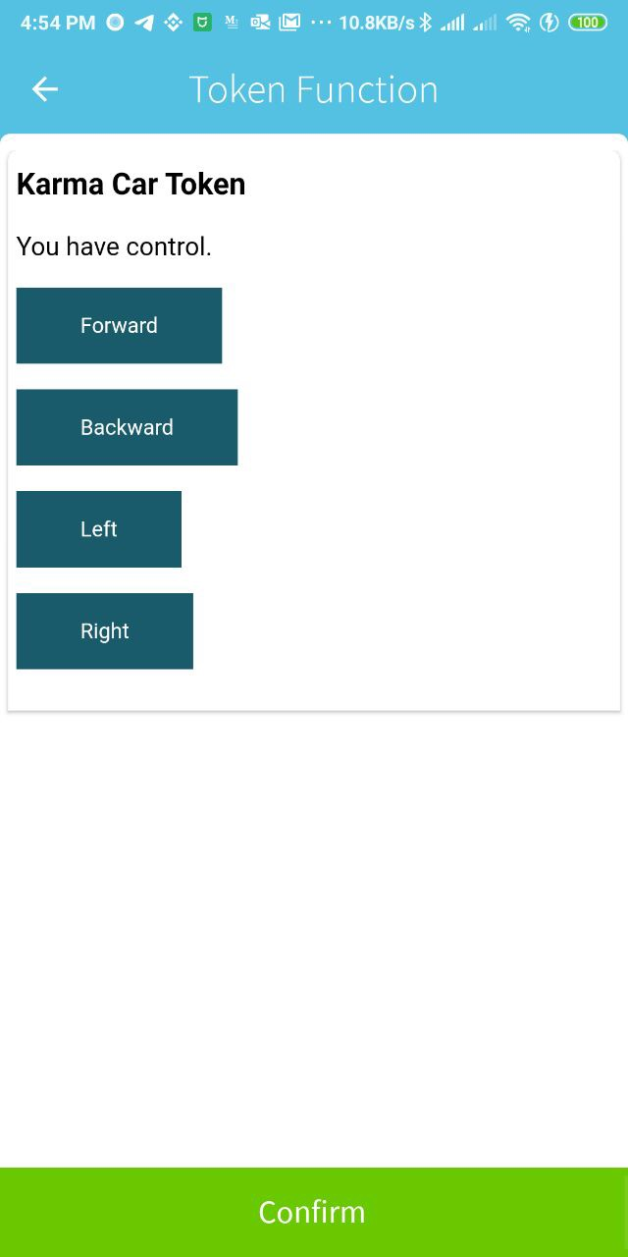
TECH STACK FOR CAR OWNER TOKEN
TECHNOLOGIES AND TOOLS TO ENABLE TOKENIZATION
USER GATEWAY
Token/DApp
KARMA Car Token/Car DApplet
L4
Wallet
AlphaWallet
L3
APIs & Languages
TokenScript
L2
2nd Layer Protocols
EIP875
L1
Zero/low-trust Interaction protocols
Ethereum
ALPHAWALLET SCREENSHOTS

Slide 7
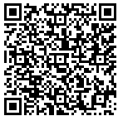
SCAN QR TO EXPERIENCE THE KARMA OWNERSHIP TOKEN
Only one car is available, first come first serve
It will cost you 1.99 Rinkeby, you will get a token enabled toy car
If you get the token, come to me after the talk ☺

Slide 8
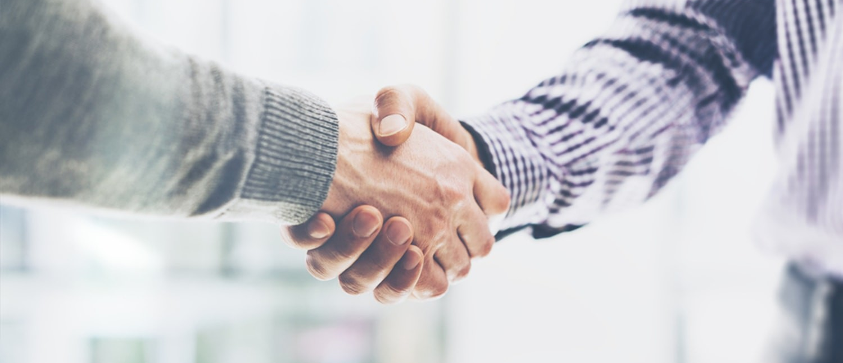
THANK YOU
WEBSITE
GITHUB
https://AlphaWallet.com
https://github.com/AlphaWallet
VICTOR ZHANG
Victor.zhang@alphawallet.com
+61 426 101 860
@victor928

